Slide 1
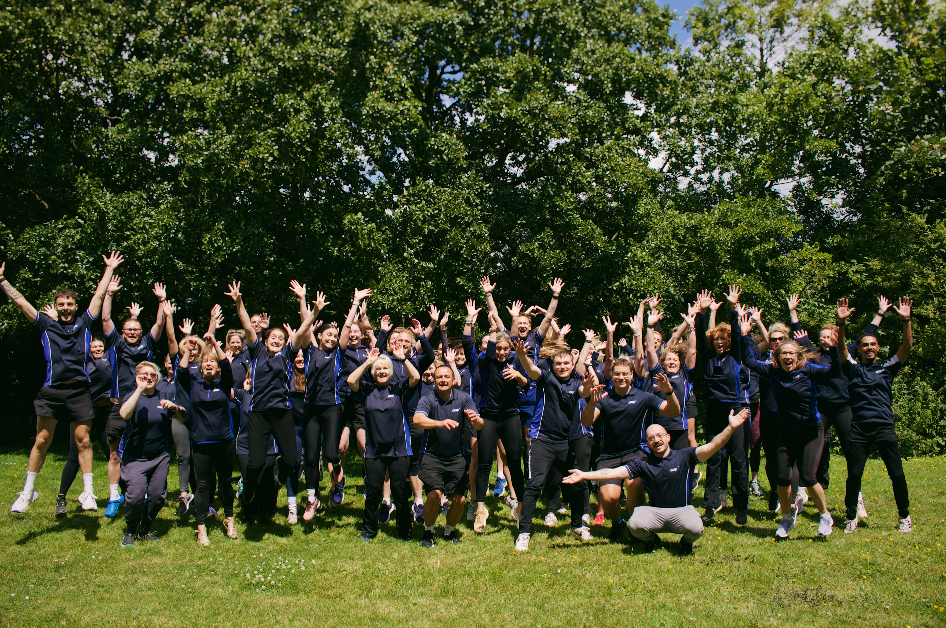


COASTAL PLACE PARTNERSHIP

Slide 2
HAYLEY BULLOCK
Strategic Place Partnership Manager - Coastal

Slide 3

OUR VALUES:
Passionate, Inclusive, Dedicated, Inspiring, Connected
OUR MISSION:
Somerset Activity and Sports Partnership (SASP) is dedicated to increasing the health and happiness of residents in Somerset through physical activity and sport

Slide 4


Slide 5
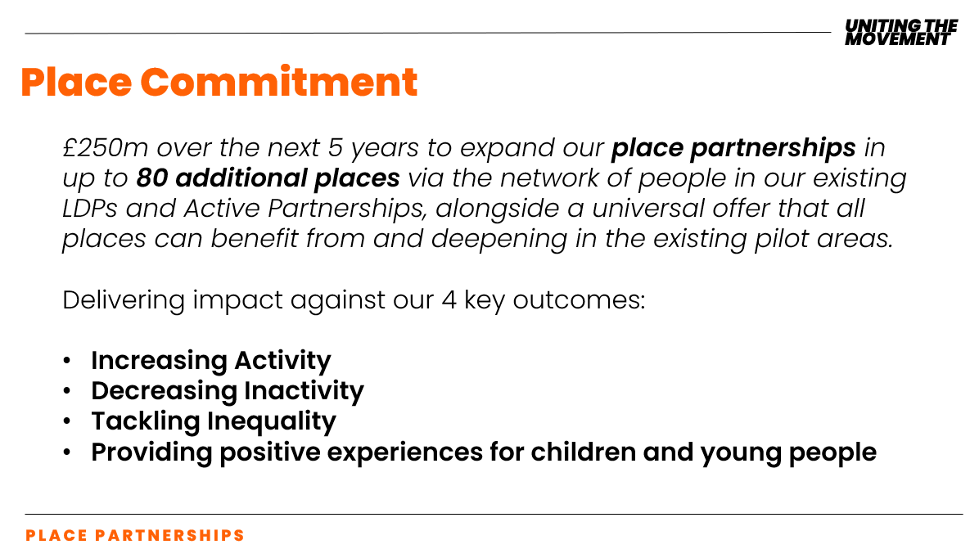

Slide 6
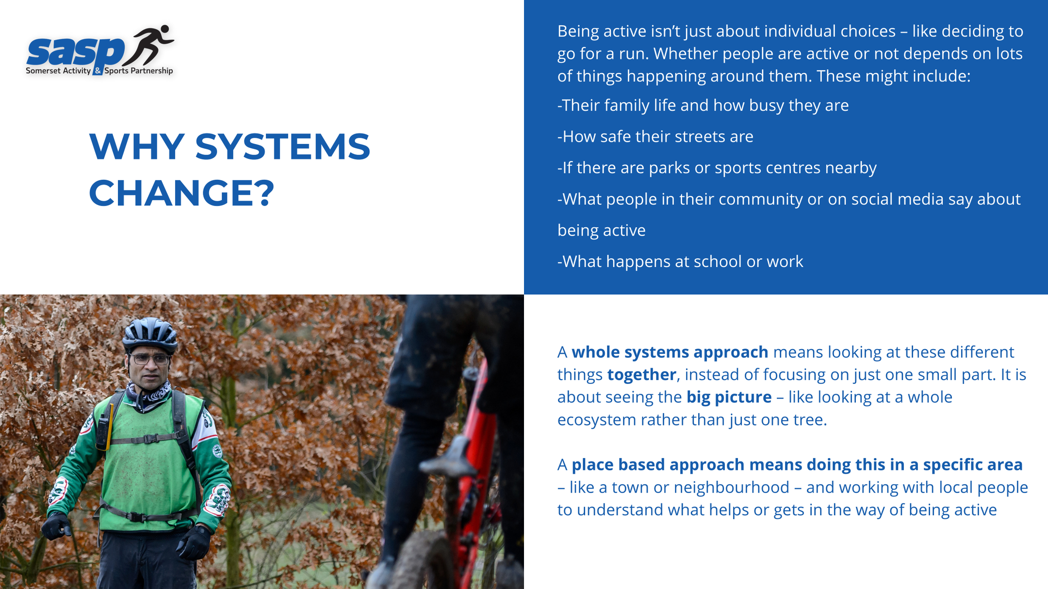

Slide 7
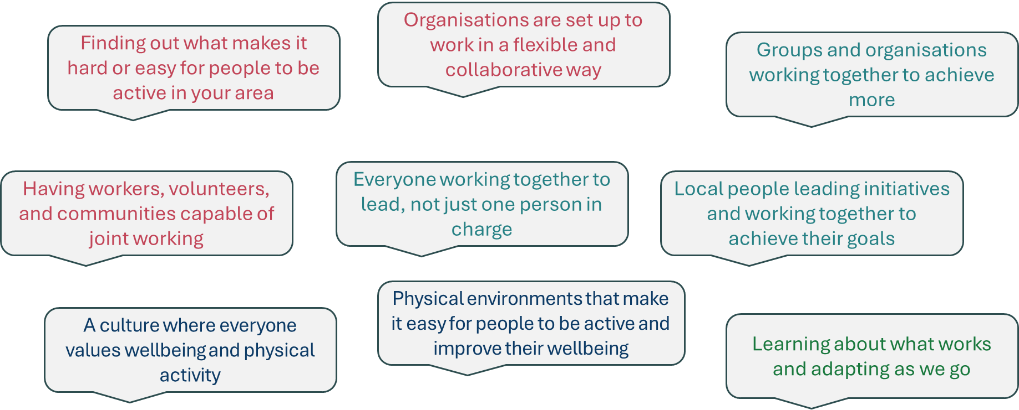
9 CONDITIONS: WHAT IS NEEDED TO ENABLE THIS WORK?
Notes:
taken from Active Devon
These are the 9 conditions of change, that can help us to do this work.

Slide 8
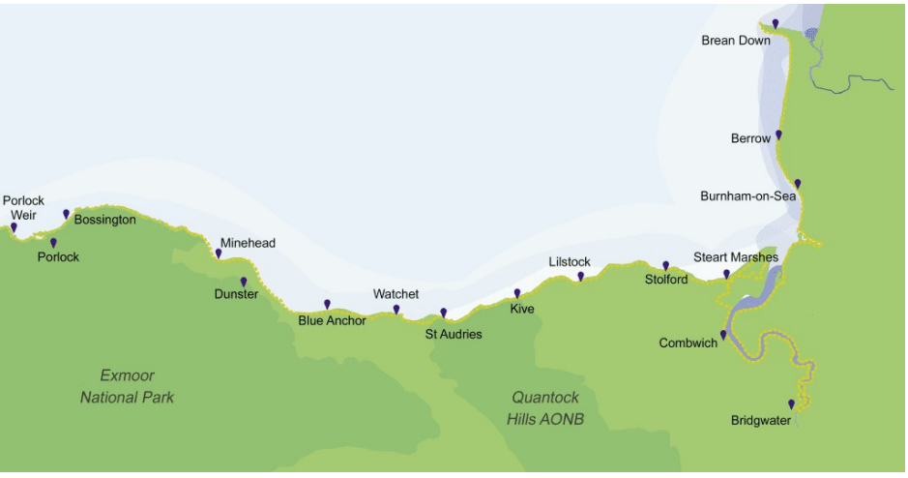




PLACES IN THE COASTAL PLACE PARTNERSHIP
MSOAs - Middle Layer Super Output Areas
  Highest Need
Porlock & Outer Minehead
Minehead
Watchet, Washford & Carhampton
Highbridge
Burnham on Sea
Highbridge
Bridgwater

Slide 9
SUMMARY: OUR PRIORITY AREAS AND PEOPLE
Priority areas for Adults:
  Bridgwater North: Adults in NS-SEC 6-8 and adults with no qualifications
  Highbridge: Adults who have a disability or long term health condition
  Watchet, Washford & Carhampton: adults aged 65+ , adults who have a disability or long term health condition and retired adults
Highbridge
Priority areas for CYP:
  Bridgwater South: Girls and low affluence families
  Bridgwater Town: low affluence families
Areas for further exploration:
  Adults: Burnham-on-Sea
  CYP: Minehead outer, Watchet, Washford & Carhampton, Highbridge, Bridgwater North
Notes:
Data: Place needs classification https://www.sportengland.org/research-and-data/research/place-need-assessments/data-tables
What next?
Prioritise areas with the greatest disparities and barriers to activity
Identify hotspot areas where interventions can be most effective

Slide 10

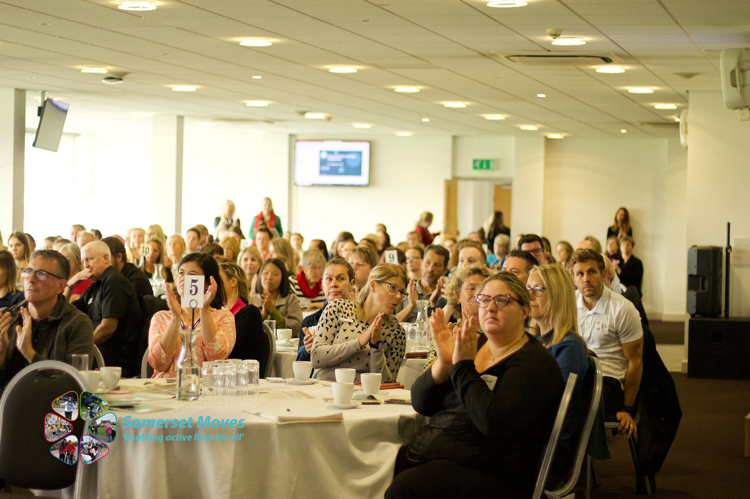




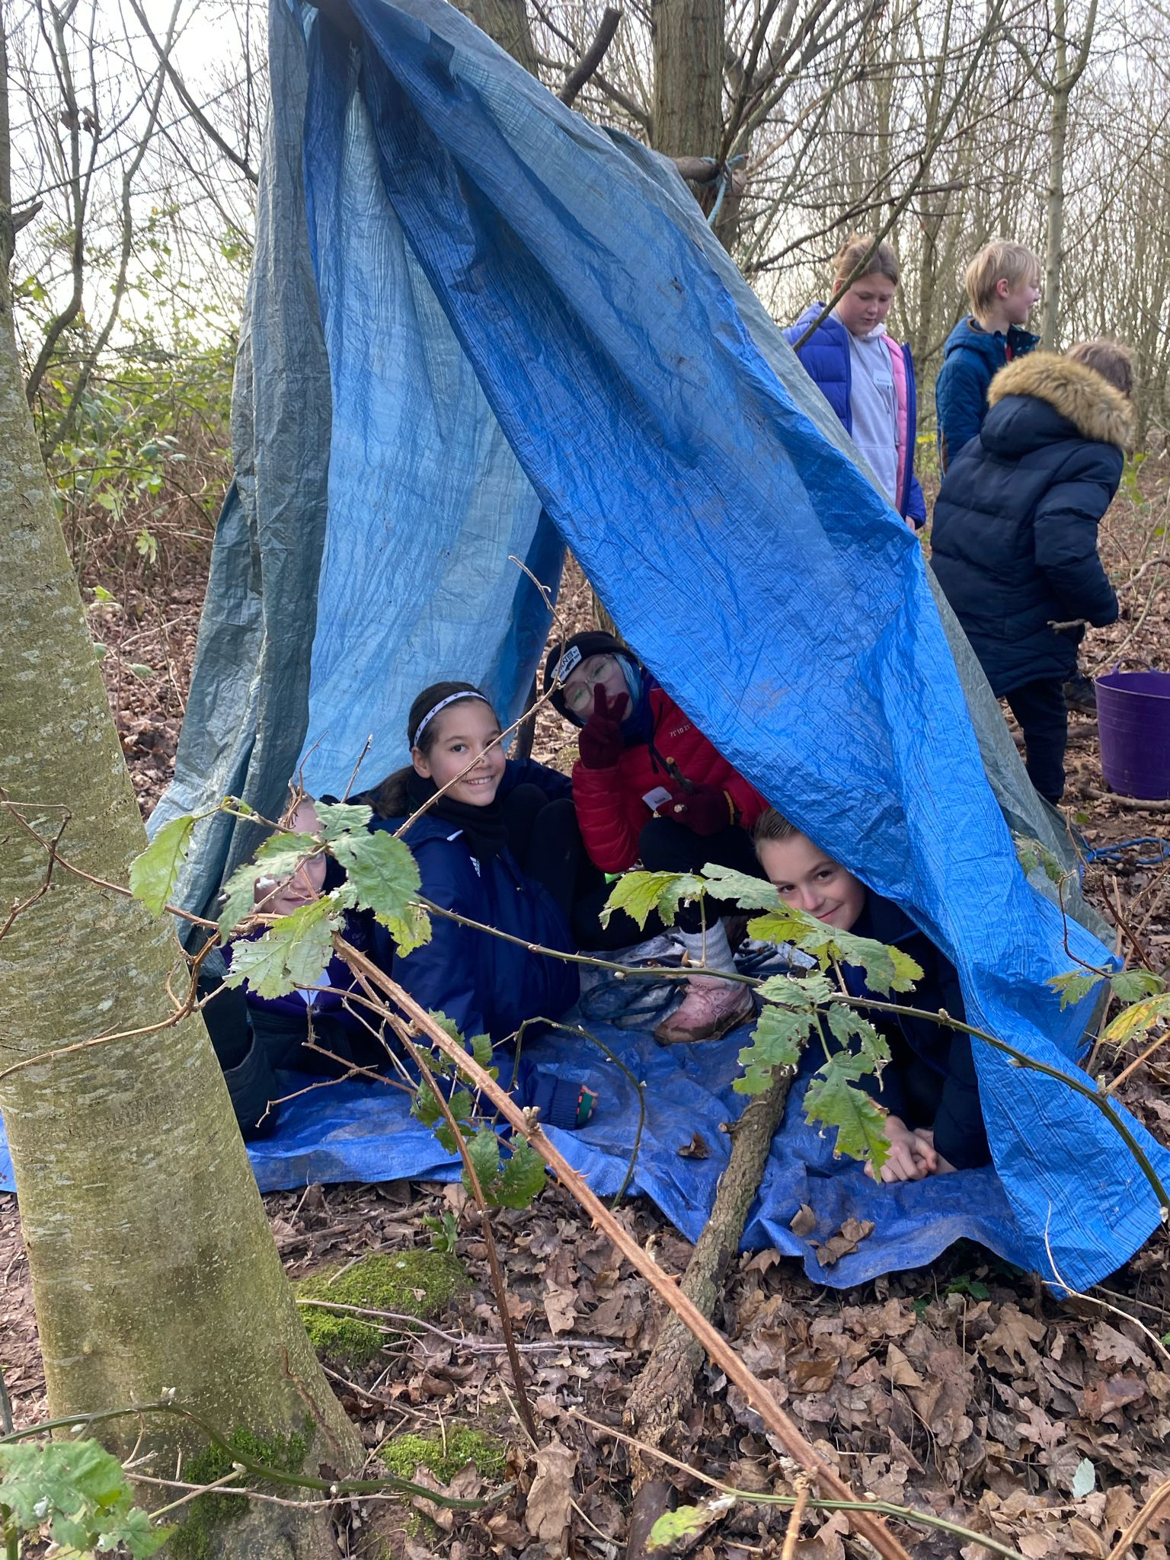



OUR PRIORITIES
Supporting active places
Embedding physical activity in all aspects of a place
Active travel
Working collaboratively to embed physical activity and sport into health systems
Campaigns which challenge perceptions on who can be active and how
Developing system leadership

Slide 11


SASP Internal Place Partnership Project Team
SASP Internal Place Partnership Project Team
Purpose: This team will support the Place Partnership with data and
evaluation, project management and financial administration
Neighbourhood Groups
Purpose: Granular place-based insight, decision-making, and co-design
Functions:
  Identify local priorities
  Co-produce local projects and test initiatives
  Feed insight to Strategic Group
  Trial and adapt engagement / delivery methods
  Steward community voice and lived experience
Place Stakeholder Group
Purpose: Open to all who have an interest in the Somerset Coastal Place Partnership
  Strategic Oversight Group
  Place Leadership Co-hort
  Community Groups
  a Lived Experience Advisory Partnership (LEAP)
  Locally Trusted Organisations (LTO)
Measurement, Evaluation and Learning(MEL)Group
Purpose: Check and challenge the evaluation and learning approach, and share expertise on how to move forward with the evaluation and learning
Functions:
  Check and challenge the Theory of Change and explanatory accounts
  Provide advice and expertise on methods
  Analyse data, insight and learning and recommend adaptations
  Coordinate with HDRC and Somerset Moves
  Contribute to sustainability
Communications and Engagement Group
Purpose: To lead, coordinate, and align strategic communication efforts across the Somerset Coastal Place Partnership.
Functions:
  Strategic alignment of comms to reflect a shared vision for place
  Collaborative messaging and campaigns
  Embed principles of co-production and insight-driven design in comms
  Digital lead around access and innovation
  Partner Support and Coordination
  Track engagement and reach across campaigns to refine comms insight
Strategic Oversight Group
Purpose: Strategic leadership, oversight, and resource alignment
Functions:
  Oversight of shared ambition and progress
  High-level decision-making on funding allocation and priorities
  Accountability for MEL framework and outcomes
  Risk management and escalation
  Ensures alignment with Somerset Moves, HDRC and LA priorities
  Endorses community voice and insights from neighbourhood level
West Somerset
Bridgwater
North Sedgemoor
  Place based insight & decision making
  Identify local priorities
  Report to Strategic Oversight
  Place based insight & decision making
  Identify local priorities
  Report to Strategic Oversight
  Place based insight & decision making
  Identify local priorities
  Report to Strategic Oversight
Communications
&
Engagement
Place
Stakeholder
Group
Measurement Evaluation & Learning
Strategic Oversight
  Shared ambition & process
  Accountability MEL
  Risk Register
  Alignment with wider system
E.g. Early help, Educ, CCS, ASC
Connect Somerset Steering Group
Somerset Board
Somerset Coastal Place Partnership - Governance Development
(Updated January 2026)

Slide 12
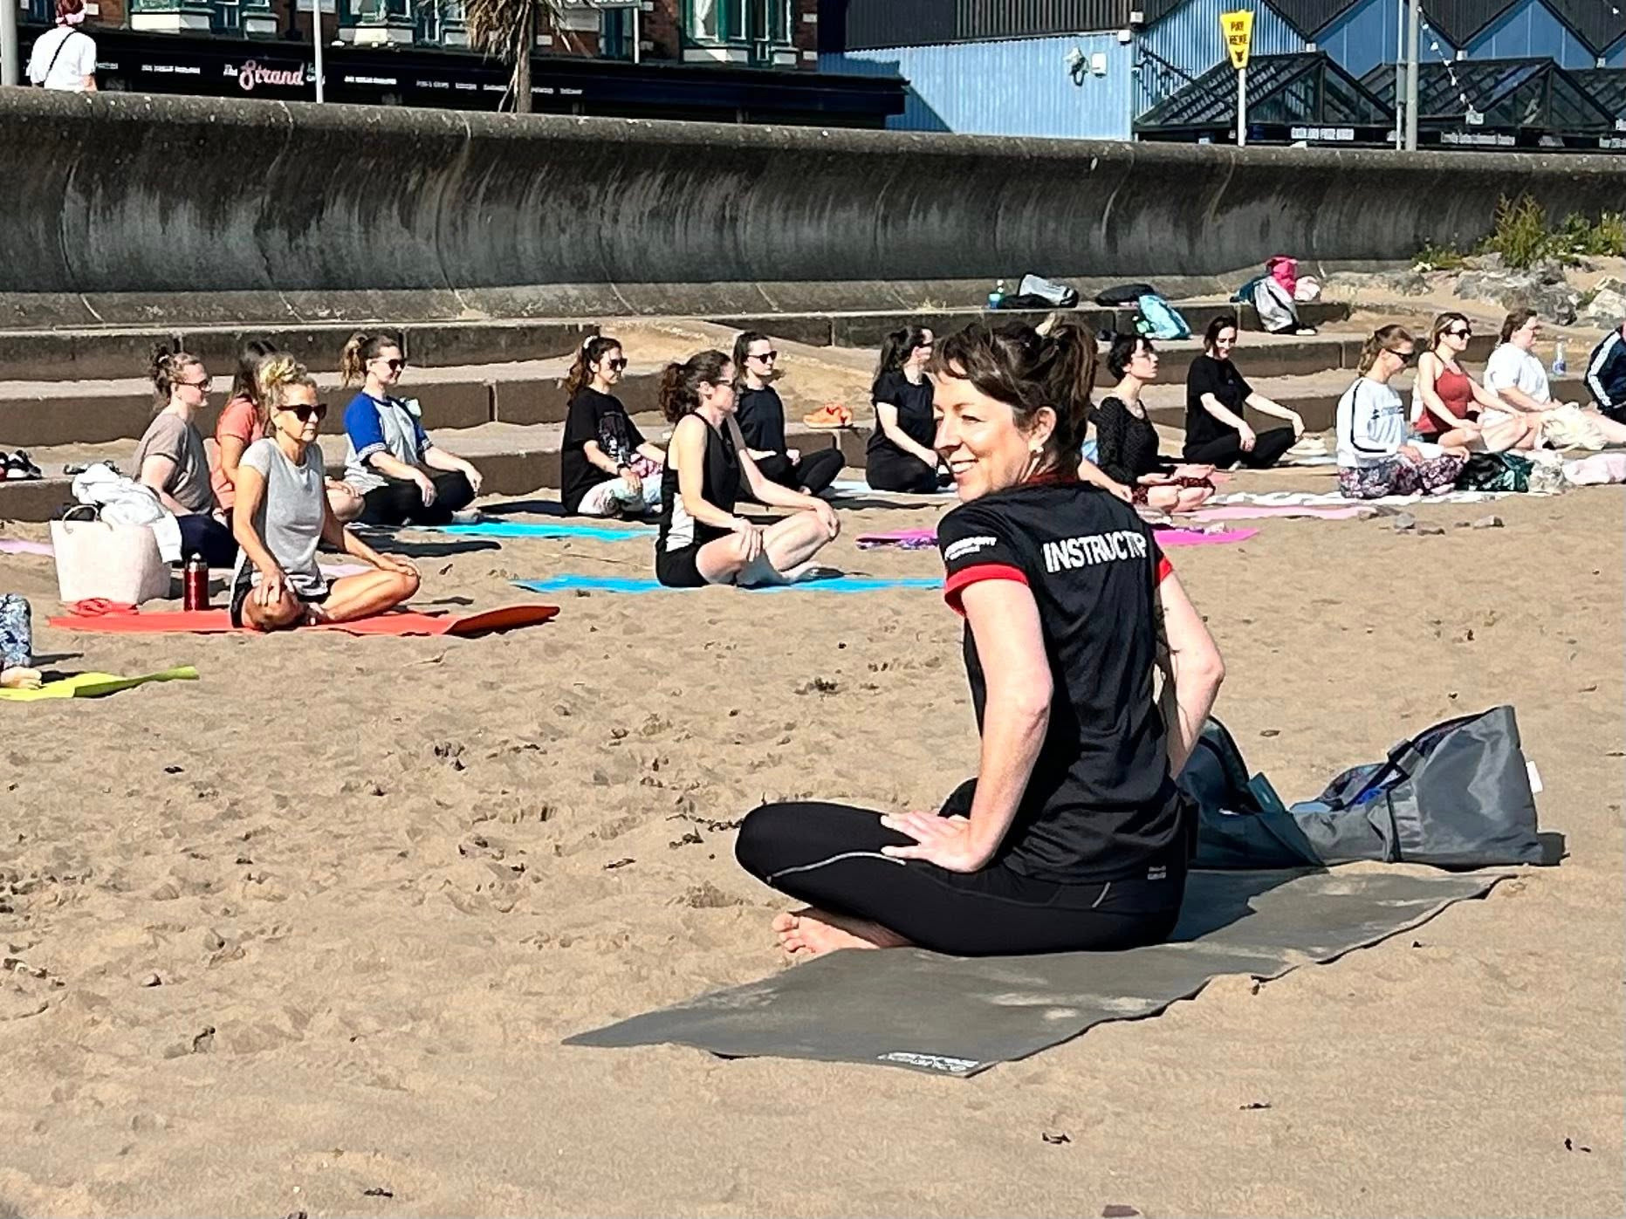
WEST SOMERSET
Locally Trusted Organisations:
Minehead Eye: Homestart:
Minehead & Coast Development Trust
Beach Yoga - Minehead : Restarting 25th May
Outdoor Yoga - Williton : 27th May
Falls prevention - Porlock (12th June)
Minehead Community Hospital
Positive experiences for children and young people - Skills for Sport Recruitment
Access to green and outdoor spaces
Mobility Hubs
Facility Development
Minehead Pool Feasibility Study

Slide 13
email: Hbullock@sasp.co.uk

