Slide 1

Community Health & Wellbeing Grants Awarded
60 Grants from £600 to £35,000
TOTALLING OVER £565,000
With LCN grants this represents 169 separate parishes and includes projects in multiple areas:
                Art, Creativity & Culture
                Community Hubs, Events & Engagement
                Community Plans, Surveys & Information
                Community & Public Transport + Active Travel
                The Environment, Food & Growing
                Physical & Mental Wellbeing
                Young People
You can see all the projects we’ve funded on the
Community Health & Wellbeing website

Slide 2
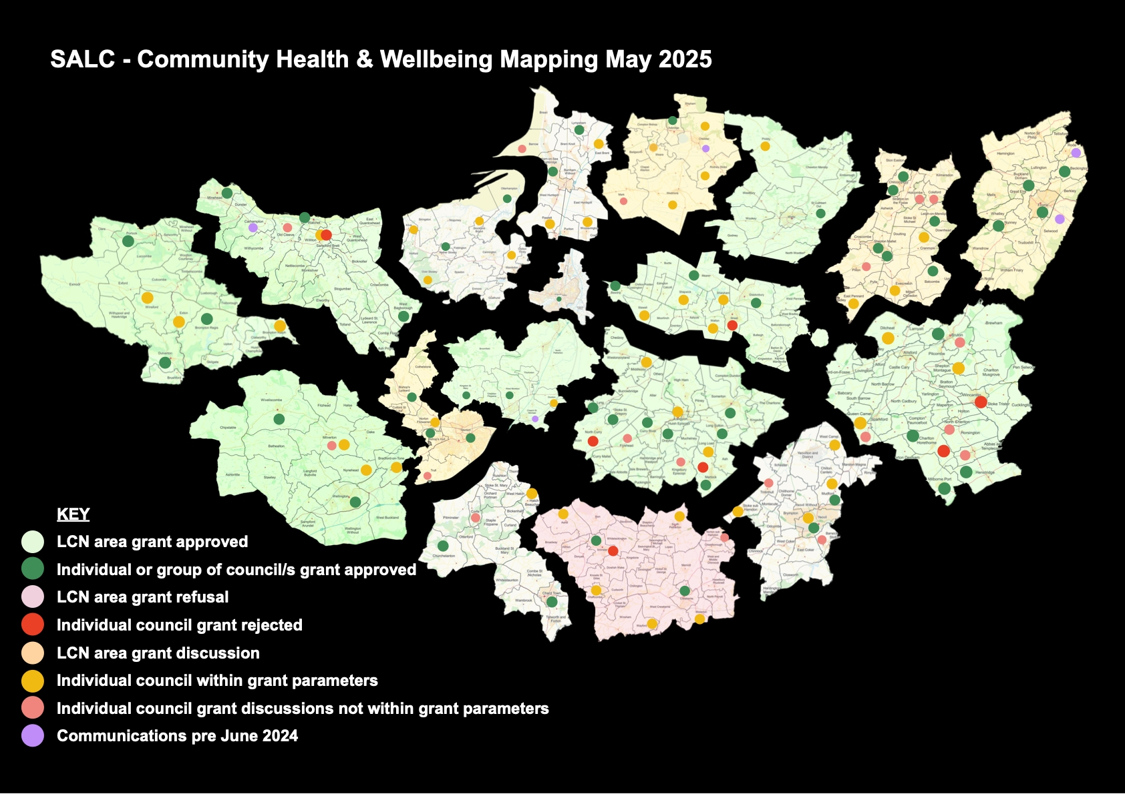

Slide 3
SPARK & SALC Community Health & Wellbeing Roadshow
Saturday 11th April - 10 til 1pm – Chilthorne Domer Village Hall
Wednesday 15th April – 6 til 9pm – EMN Hall Monksilver
Find out more about:
Community Engagement & Community Plans
Insights Hub
Parish, Town & City Councils collaborations with VCFSE Organisations
Youth Alliance - impact and provision
Funding Opportunities - Beyond the Precept
Join us to learn about positive collaborations
Book via SALC website or email Lilly:
Lilly Keeley Watts HWBAdmin@somerset-alc.org.uk

Slide 4
SALC Parish, Town & City Council Survey
Your insight will help SALC understand:
The challenges Parish, Town &. City Councils are experiencing
The opportunities emerging for Parish, Town & City Councils in Somerset’s two-tier landscape
How SALC can best represent and support Parish, Town & City Councils in Somerset moving forward
The deadline for submitting a response is 30 April 2026.
SALC Parish, Town & City Council Survey

Slide 5
What next?
Our grant programme has closed to applications. But Fodo & Lilly are still here to support parish, town and city councils with any projects related to Health & Wellbeing.
We have expertise in a number of fields including:
Community Engagement
Community Plan Development or Information Gathering
Event Organisation
Fundraising & Writing Funding Applications
Developing Connections with Outside Organisations
Evaluation Techniques
AND we have a small amount of funding to help with the above – ideally for smaller parishes.
BUT we’re here to work with all councils.
If you need us get in touch
Fodo & Lilly
Fodo Higginson & Lilly Keeley Watts
Community Health & Wellbeing Team
Somerset Association of Local Councils
HWBSupport@somerset-alc.org.uk
Mb: 07932265419
Visit our Website
Visit our Facebook page

